Slide 1
Tortoise SVN

Slide 2
Group Members
Su Yee Myint
Phu Pwint Aung
Khaing Zin Thet
Nant Julia Aung

Slide 3
Why Need Configuration Management Tool?
Software systems are constantly changing during development and use.
Need CM because it is easy to lose track of what changes
CM is essential for team projects to control changes made by different developers

Slide 4

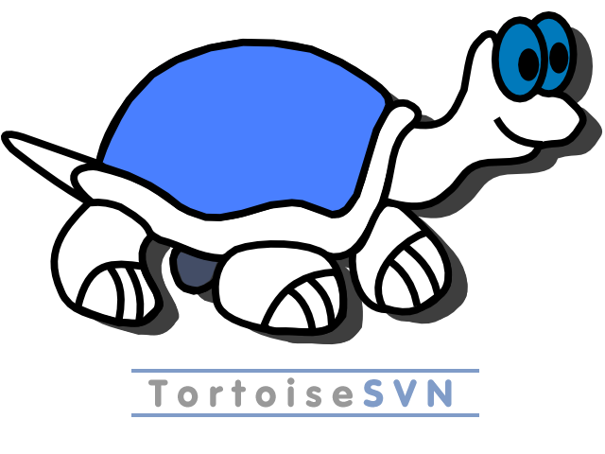
Tortoise SVN + Deveo Hosting

Slide 5
Tortoise SVN
to use Revision control / version control / source control software
based on Apache™ Subversion (SVN)
Tortoise SVN provides a nice and easy user interface for Subversion.
developed under the GPL

Slide 6
Features of Tortoise SVN
Easy to use
See the status of your files directly in the Windows explorer
allows moving files by right-dragging them in the Windows explorer
Powerful commit dialog
Helpful tools
Tortoise Merge
Tortoise Diff
Available in many languages

Slide 7
Features of Tortoise SVN(cont’d)
All Subversion protocols are supported
http://
https://
svn://
svn+ssh://
file:///
svn+XXX://

Slide 8
Functions of Tortoise SVN
Browse repository
Add file/folder to repository
Checkout a working copy
Get Lock/Release repository files
Commit to repository
Update working copy
View differences
Resolve conflicts
Revert Changes
Merge files

Slide 9
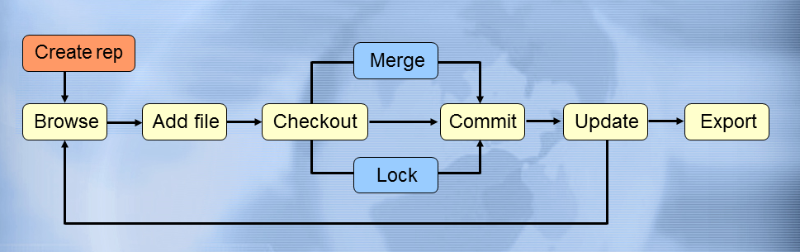
Flow of Tortoise SVN

Slide 10
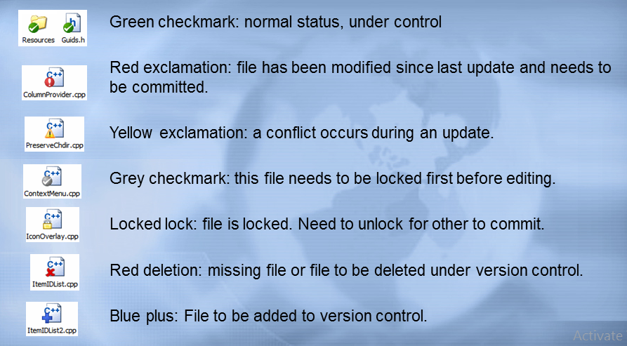
Status of version control of file/folders

Slide 11
Let’s Make a Practice!

